Slide 1
Capstone Project
Customer Segmentation
By
Govind Wakure

Slide 2
Outline
Introduction
Problem Statement
What is Customer Segmentation?
Data Description
Data Exploration
RFM Segmentation
Feature Extraction
K-Means Clustering
Conclusion

Slide 3
Problem Statements
Customer segments on a transnational data set which contains all the transactions occurring between 01/12/2010 and 09/12/2011 for a UK-based and registered non-store online retail. The company mainly sells unique all-occasion gifts. Many customers of the company are wholesalers.

Slide 4
What is Customer Segmentation?
Customer segmentation is the process of separating customers into groups based on their shared behavior or other attributes. The groups should be homogeneous within themselves and should also be heterogeneous to each other.
The main goal is to identify customers that are most profitable and the ones who churned out to prevent further loss of customer by redefining company policies.
Having large number of customers, each with different needs it is crucial to find which customer are most important for business and target them with appropriate strategy.

Slide 5
Data Description
InvoiceNo: Invoice number. Nominal, a 6-digit integral number uniquely assigned to each transaction. If this code starts with letter 'c', it indicates a cancellation.
StockCode: Product (item) code. Nominal, a 5-digit integral number uniquely assigned to each distinct product.
Description: Product (item) name. Nominal.
Quantity: The quantities of each product (item) per transaction. Numeric.
InvoiceDate: Invoice Date and time. Numeric, the day and time when each transaction was generated.
UnitPrice: Unit price. Numeric, Product price per unit in sterling.
CustomerID: Customer number. Nominal, a 5-digit integral number uniquely assigned to each customer.
Country: Country name. Nominal, the name of the country where each customer resides.

Slide 6
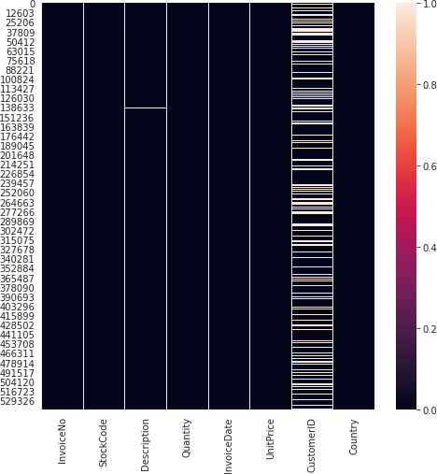
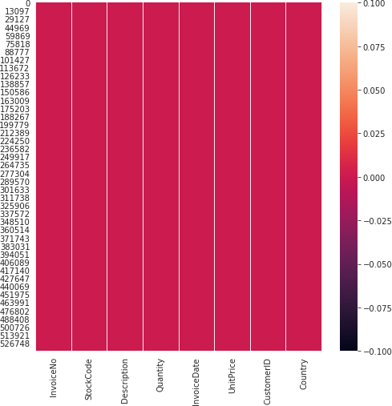
Data Exploration

Slide 7
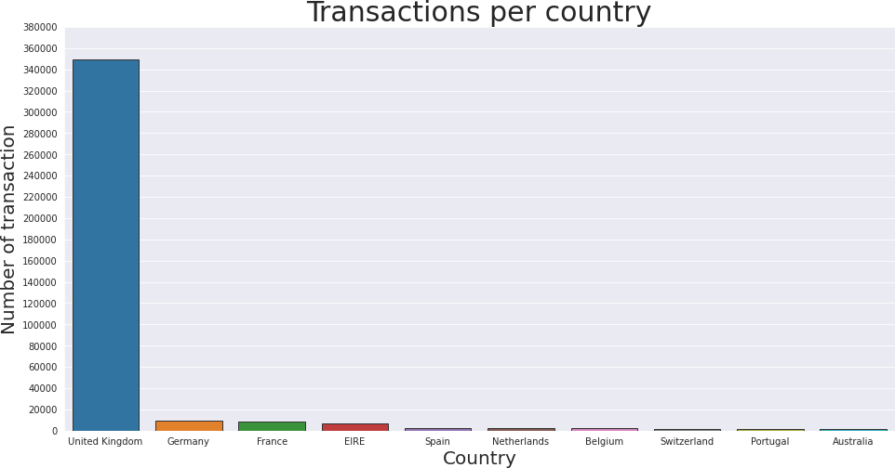

Slide 8
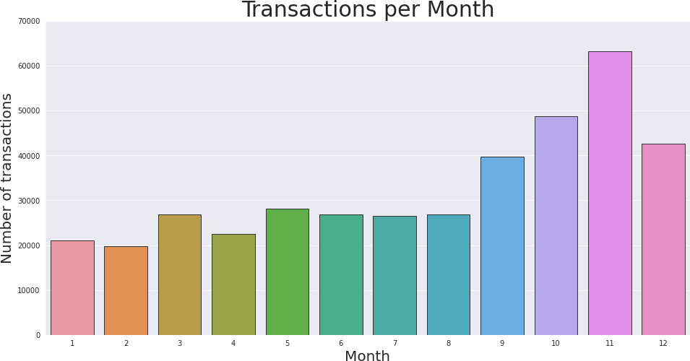

Slide 9
RFM Segmentation
RFM stands for Recency, Frequency and Monetary
RFM analysis is commonly used technique to generate and assign a score to each customer based on:
How recent their last transaction was (Recency)
How many transactions they have made in the last year (Frequency)
What monetary value of their transaction was (Monetary)

Slide 10
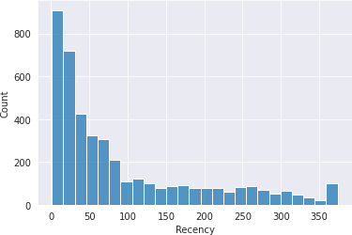
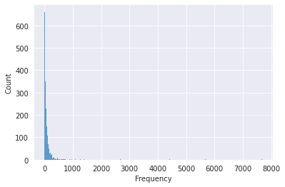
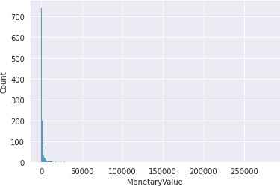
Feature Extraction

Slide 11
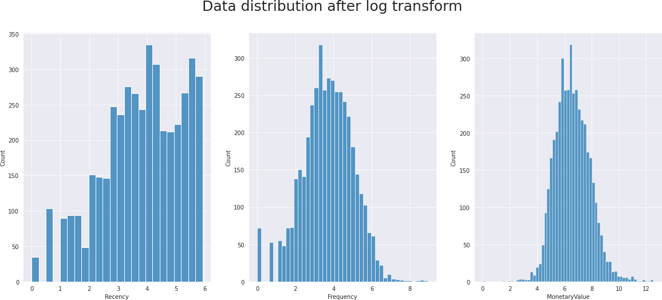

Slide 12
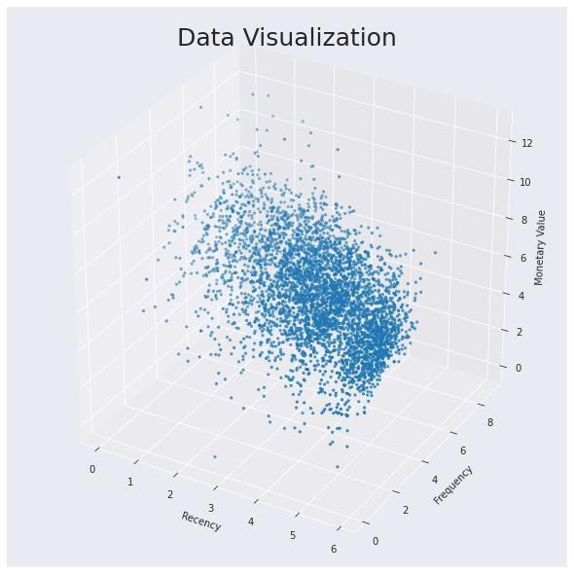
Each transaction is assigned values based on Recency, Frequency and Monetary
Each point in plot represent a
Transaction

Slide 13
Data Modeling:
K-means Clustering:
K Means clustering algorithm is an unsupervised machine learning algorithm that uses multiple iterations to segment the unlabeled data points into K different clusters in a way such that each data point belongs to only a single group that has similar properties
K means gives the best result under the following conditions
Data’s distribution is not skewed
Data is standardised
The data is highly skewed, therefore I will perform log transformations to reduce the skewness of each variable and I standardised the data
Why k-means?
As our feature variables are numerical and our goal is unsupervised to find out some sort of structure in the customers, I used k-means clustering

Slide 14
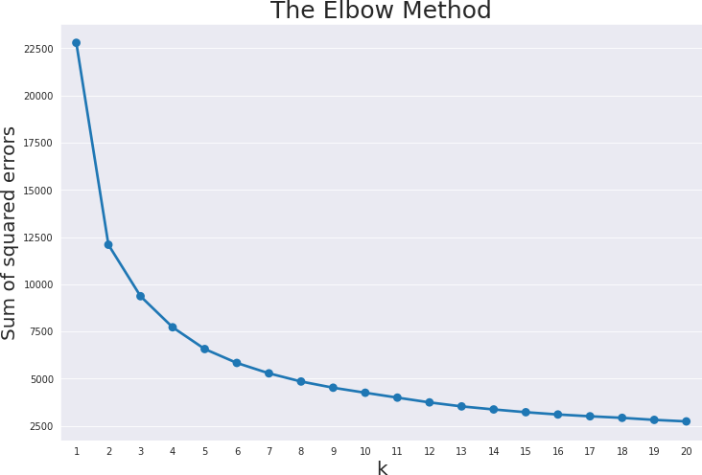
K-Means Clustering

Slide 15
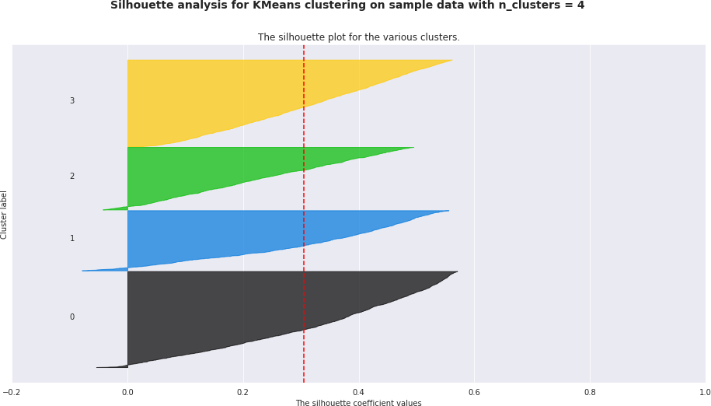

Slide 16
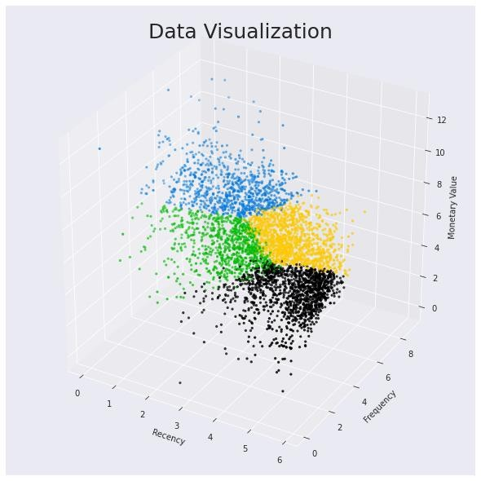
Each transaction is assigned a cluster based on Recency, Frequency and Monetary
Optimal number of cluster by
silhouette analysis is four
Each color in plot represent a Cluster

Slide 17
Mean value of each feature
Cluster | Recency | Frequency | Monetary Value
0 | 150 | 10 | 228
1 | 8 | 197 | 3697
2 | 15 | 30 | 486
3 | 77 | 65 | 1123

Slide 18
Conclusion
The customer segments thus deduced can be very useful in targeted marketing, scouting for new customers and ultimately revenue growth. After knowing the types of customers, it depends upon the retailer policy whether to chase the high value customers and offer them better service and discounts or try and encourage low/ medium value customers to shop more freqently or of higher monetary values.
The visualization of clusters in Silhoutte Analysis show some overlapp between the customer segments.However, the dataset does not distinguish between wholesale and retail customers, it is quite likely that high value frequent clients are the wholesale dealers and medium/ low valued ones are individual retail purchasers.

Slide 19
Conclusion
Cluster | RFM Interpretation | Type of Customer
0 | Last purchase long ago, Least number of transactions, Least monetary spending | Churned
1 | Recent transaction, Most frequent transactions, Highest monetary spending | Best (target)
2 | Recent transaction, Low purchase frequency Low monetary spending | New
3 | Last purchase while ago, Less frequent transactions Low monetary spending | At Risk

